Slide 1
Reporting in Microsoft Dynamics NAV 2009
REPORTING
NAME
COMPANY

Slide 2
Objectives And Takeaways
Session Objectives:
  Learn to design, modify and build reports for both Classic and RoleTailored Client
  Plan and prepare the work required for reports in the RoleTailored Client
Key Takeaway 1
  New reporting run-time, rendering and report design experience
Key Takeaway 2
  Best practices for creating reports that resembles the Classic reports

Slide 3
New Report Design
Expanded runtime options with Reporting Services
  Richer formatting capabilities and functionality
  Interactive Reports
  Out-of-the-Box Export to PDF and Excel
Integrated Design Experience for Both Clients
  Integration of existing designer with Visual Studio
  Support two clients with one report

Slide 4
Creating A New Report – Classic client
New Report
Object Designer
Add Data Items
Section Designer
Add Fields
Save/
Compile
Create Layout
Add to Form
Form Designer
Add to Menu
Menu Designer
View
Classic Client

Slide 5
Report Design
Reports for the RoleTailored client

Slide 6
Creating a report for RoleTailored client
New Report
Object Designer
Create Layout Suggestion
Adjust Layout
Create Layout
Add Data Items
Load Layout
Save Layout
Add New Controls (optional)
Section Designer
Add Fields
Save/
Compile
Save/
Compile
Add to Page
Page Designer
Visual Studio
Create Layout
Create Layout
Add to Form
Form Designer
Add to Menu
Menu Designer
Add to Menu
Menu Designer
View
Report
Viewer
View
View
Classic Client
RoleTailored Client

Slide 7
Changes to the Report Object
Used when Report is run in the Classic client
Report Object
Sections/Layout
Section Triggers
Request Form
Section/Fields
Data Items
RDLC
Request Page
Used when Report is run in the RoleTailored client
The Report object with all components

Slide 8
Differences to be aware of…
Runtime DataSet Generation
Layout Differences

Slide 9
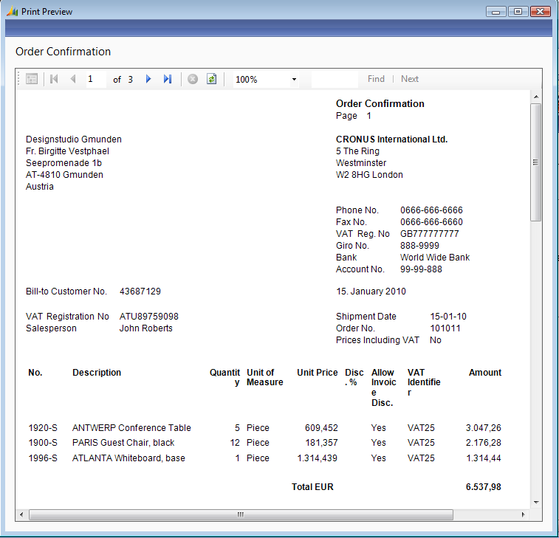
Runtime Data Set Generation
No | Description | Amount | No | Description | Line Amount | VAT Type | VAT Amount
10000 | Description | 10000 | 1 | Line 1 | 10 | null | null
10000 | Description | 10000 | 2 | Line 2 | 11 | null | null
10000 | Description | 10000 | 3 | Line 3 | 12 | null | null
10000 | Description | 10000 | 4 | Line 4 | 13 | null | null
10000 | Description | 10000 | null | null | null | VAT10 | 100
10000 | Description | 10000 | null | null | null | VAT25 | 250
20000 | Description | 20000 | 1 | Line 1 | 10 | null | null
30000 | Description | 10000 | 1 | Line 1 | 10 | null | null
30000 | Description | 10000 | Null | Null | Null | VAT10 | 100
No (Header) | Description (Header) | Amount (Header)
10000 | Description | 10000
No (Line 1) | Description (Line1) | Line Amount (Line1)
1 | Line 1 | 10
2 | Line2 | 11
VAT Type | VAT Amount
VAT10 | 100
VAT25 | 250
No (Header) | Description (Header) | Amount (Header)
20000 | Description | 20000
No (Line 1) | Description (Line1) | Line Amount (Line1)
1 | Line 1 | 10
No (Header) | Description (Header) | Amount (Header)
30000 | Description | 10000
No (Line 1) | Description (Line1) | Line Amount (Line1)
1 | Line 1 | 10
VAT Type | VAT Amount
VAT10 | 100

Slide 10
Runtime Data Set Generation
One DataItem similar to SQL Statement: Select Column From Table
Two nested DataItems similar to SQL Statement: Select Column from Table A Inner/Outer Join Table B On ColumnA = ColumnB
Two DataItems on same level similar to SQL Statement: Union All
Adding fields for Grouping, Filtering, Formating and Multilanguage

Slide 11

Layout Differences
C/SIDE
Multiple Headers, Bodies, Footers
Precision Layout
Support for Non-TrueType Font
Data Fields in Header
Reporting Services
One Header, One Body, One Footer
”Table” Layout
Only TrueType Font
Only reference to Data Fields in Header

Slide 12
The 3 most important learnings…
What is not supported directly anymore
Impact on code
Tips and Tricks for developers

Slide 13
What is not supported directly anymore
Code on section triggers
Layout specific CurrReport functions like NewPage(), ShowOutput()
CreateTotals()
Dynamic section printing based on a request form parameter
No Transheader/TransFooter functionality in Reporting Services
Changing the PaperSource via code. Printer drivers needs to be configured

Slide 14
“Unsupported” functionality
Create totals and grouping per page

Slide 15
Impact on code
Conditional coding in RDL
Adding fields to the dataset
”Printing on more than one page”
”Visible” vs BlankZero
”Truncate” vs CanGrow
Use of Option Fields
Use of Booleans
Header fields
Hidden fields
Margin/page size issues
Formats fields
  Decimals
  Dates
Caption fields
New page per group

Slide 16
Impact on code
Adding code and conditional view

Slide 17
Tips and Tricks for developers
Take a good look at the new data set
What should the report actually do – How many different layouts should it support
  Visual Studio Hotfix - http://hotfix/FixDetails.aspx?fixid=344284
Compiler output shows unsupported issues
Plan for time to spend on each report
Look at the available reports for solutions

Slide 18
Enhanced functionality
Graph and Dynamic report
Notes:
Add graph
Sorting

Slide 19
Summary
New reporting run-time, rendering and report design experience
Expanded reporting design capabilities
Take the time to learn the new environment

Slide 20
Alternative Solution
Run Classic Client Report in RoleTailored Client
  Requires that Classic Client is installed on the Client

Slide 21
Questions?

Slide 22

© 2006 Microsoft Corporation. All rights reserved.
This presentation is for informational purposes only. Microsoft makes no warranties, express or implied, in this summary.

Slide 23
Appendix

Slide 24
Visual Studio Hot fix
Why do I need it?
If this hotfix is not installed all Zindex’es will be updated in you report object if you make any changes to it layout in Visual Studio. And if you need to compare the report before and after the change, this compare will be hard to do. Windiff will show differences throughout the report.
How to get the hotfix:
Currently each partner and customer will need to request this by CSS. Ongoing investigating if we can place this hotfix on our product DVD.
Where does this work and where does it not:
This fix is for Visual Studio 2005 ONLY. (Both Web Developer and Visual Studio Pro and up.)
This fix will NOT work on Visual Studio 2008. (Both Web Developer and Visual Studio Pro and up.)
This fix will be included in the coming service packs for Visual Studio 2005 and Visual Studio 2008.

Slide 25
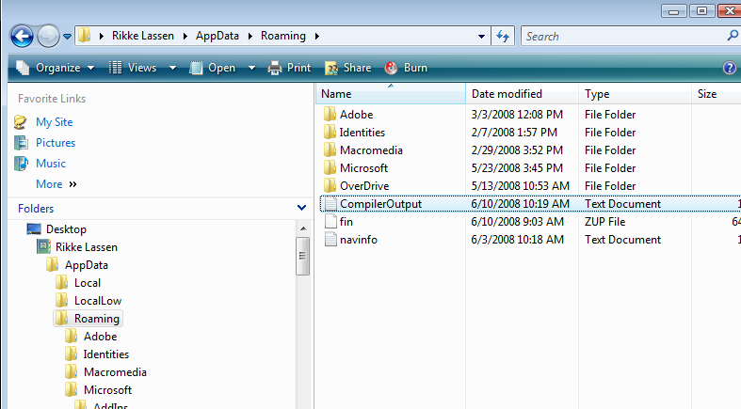
Compiler Output

Slide 26
Definition of dataset
Label controls in any section will turn into a DataSet field.
TextBox controls in all header sections will turn into a DataSet field.
TextBox controls in all body sections will turn into a DataSet field.
TextBox controls in all group header sections will turn into a DataSet field.
TextBox controls in all transheader and transfooter sections will not turn into a DataSet field.
TextBox controls in all group footer and footer sections will not turn into a DataSet field if a matching source expression is found on a control in the body section.
PictureBox controls follow the same rules with the TextBox controls.
Shape controls are ignored.
If a textbox is of type decimal an extra field is added for formatting.

Slide 27
Definition of dataset
Idea is to treat each label and textbox as a column in the resulting dataset
Simple rules apply to naming
  Each control is prefixed with the name of the dataitem
  Totals will not be added to dataset
  Controls that appears with same sourceexpression in several sections will be added once
  All files can be overwritten if needed

Slide 28
Definition of dataset
We add primary key for all dataitems in dataset even if they are not referenced in sections
We add columns used for groupings even if they are not referenced in sections
We add format strings for controls containing currency amounts

Slide 29
Definition of dataset
Textboxes in Group Footer and Footer
  These will be turned into Sum() expressions based on another control that uses the same expression in a body section above.
  If such a control cannot be found automatically a new, invisible control needs to be added to the report section in C/SIDE.

Slide 30
Formatting
Adheres to C/SIDE Formatting Rules
Check the AutoFormatType and AutoFormatExpression properties, then use these as the formatting basis
If both were empty, go to the field’s properties in the Table metadata.
Check the AutoFormatType and AutoFormatExpression, if provided use these as the formatting basis. This will contain some C/SIDE precision string like 2:2.
If both were empty, go back to the report or form and check the DecimalPlaces property for the formatting basis. This will contain some C/SIDE precision expression like 2:2.
If DecimalPlaces property is undefined, then go back to the Table metadata.
If provided, use the field’s DecimalPlaces property for the formatting basis.
If the formatting basis was AutoFormatType and AutoFormatExpression, evaluate the expression and call Codeunit1’s AutoFormatTranslate function to get a C/SIDE Format String, in the <Precision,%1><Standard format,0> format. Here, %1 will be a precision string like 2:2.
Do the formatting based on the precision expression.
Confidential

Slide 31
Definition of dataset – Hidden fields
If a control in C/SIDE layout has a No value for its Visible property it will appear in the dataset
This allows adding new controls to C/SIDE layout for easing transformation without changing the C/SIDE runtime behavior.
No RDLC controls will be added.
This will allow AL developers to add a new field to a DataSet without disturbing the C/SIDE report layouts and use the data in those fields to manually extend the RDLC layout.

